Slide 1
Install Kubernetes on AWS with Terraform and Ansible
Stamatis Panorgios
Devops at Zulutrade Technologies

Slide 2
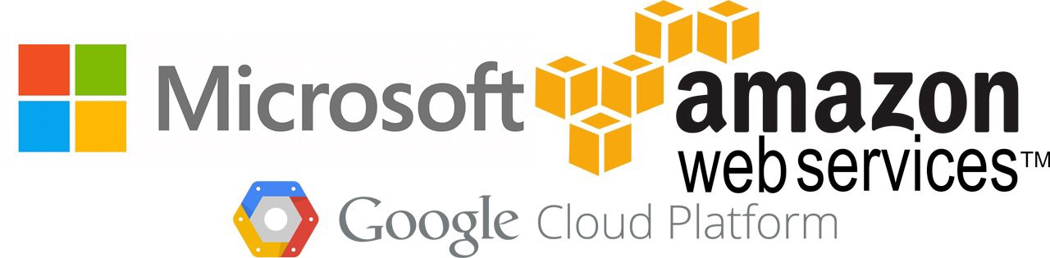
Kubernetes
Orchestrate containerised applications
Private or public cloud environments
Solves a problem generated by another solution: containerisation
Offered as a managed service but can also be installed

Slide 3
Containerisation
The process of taking an application and packaging it into a single runnable/executable software image
Containerising an application requires understanding its inputs, dependencies, configuration files, and outputs, and then baking all of these things into an immutable image
Containerisation primarily solves the problem of portability of applications between development environments and production environments

Slide 4
Kubernetes installation with...
Terraform
Terraform is a tool for building, changing, and versioning infrastructure safely and efficiently
Ansible
used for IT tasks such as configuration management, application deployment, intraservice orchestration and provisioning

Slide 5
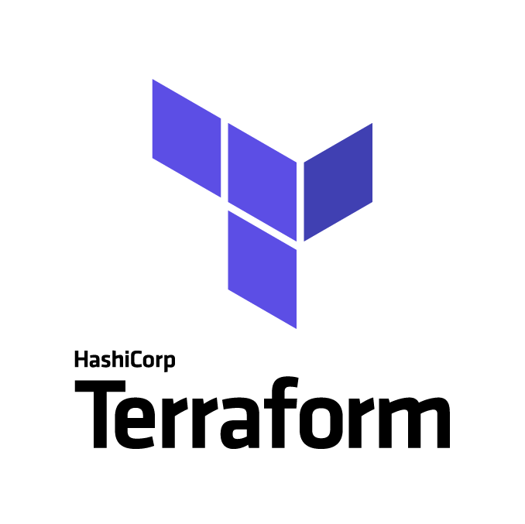

What we do with Terraform
Provision 2 EC2 instances in AWS (specific type, image, volumes)
Provision a VPC for the 2 instances
Provision a security group
What we do with Ansible
Configure Red Hat on EC2 instances for installing Kubernetes
Install docker, kubelet, kubeadm
Start services
Initialize Kubernetes Master
Join the second EC2 as a node

Slide 6
Prons/Cons of this project
PRONS
Acquire knowledge of Kubernetes internals
Full control of setup (networks, security)
Choices in logging and alerting mechanisms
Infrastructure as a code
CONS
High Skill of cloud Platform, Terraform, Ansible
Need of human recources

Slide 7
What’s next
This infrastructure can be production grade. A lot of components can be added through code such as ingress controller, service mesh, logging, alerting, monitoring systems.
All in the form of :
Infrastructure as a Code.

Slide 8

Questions

Slide 9

Source: https://gitlab.com/stap7/kubernetes-aws
Blog: https://stamatisp.wordpress.com/

